Slide 1
Data Warehousing - session -2
Mr. Atul Vaze
Certified BI Specialist(OBIEE)
Certified Agile Coach (ICP-ACC)
Function Point Specialist
Six Sigma GB

Slide 2
Books
Text Books:
T1: Ponniah P, “Data Warehousing Fundamentals”, Wiley Student Edition, 2012
T2: Kimball R, “The Data Warehouse Toolkit”, 3e, John Wiley, 2013
Reference Books :
R1 : Anahory S, & Dennis M, “Data Warehousing in the Real World”, Pearson Education, 2008.
R2 : Kimball R, Reeves L, Ross M, & Thornthwaite, W, “The Data Warehouse Lifecycle Toolkit”, John Wiley, 2e, 2012.
R3: Jiawei Han, Micheline Kamber and Jian Pei, “Data Mining: Concepts and Techniques”, Morgan Kaufmann Publishers 2012
R4: Krish Krishnan, “Data Warehousing in the Age of Big Data”, Morgan Kaufmann Publishers 2013
Note: In order to broaden understanding of concepts as applied to Indian IT industry, students are advised to refer books of their choice and case-studies in their own organizations

Slide 3
TOPICS
Design Requirements

Slide 4
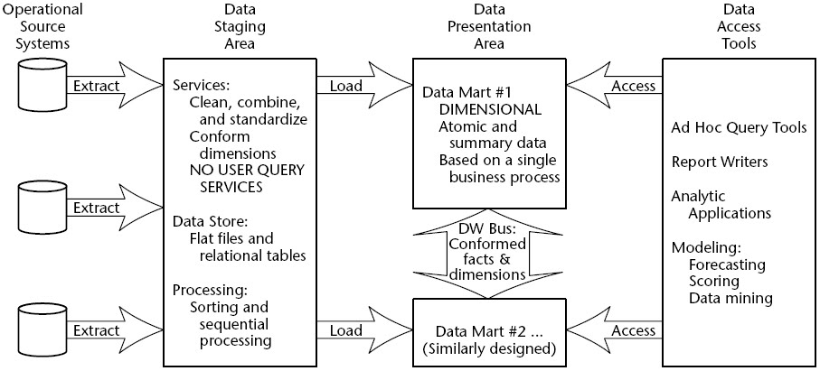
Components of data warehouse

Slide 5
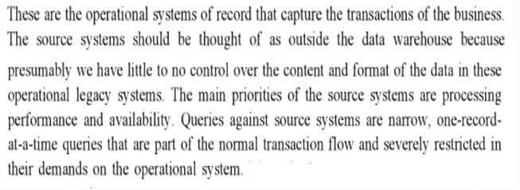
Operational Source System

Slide 6
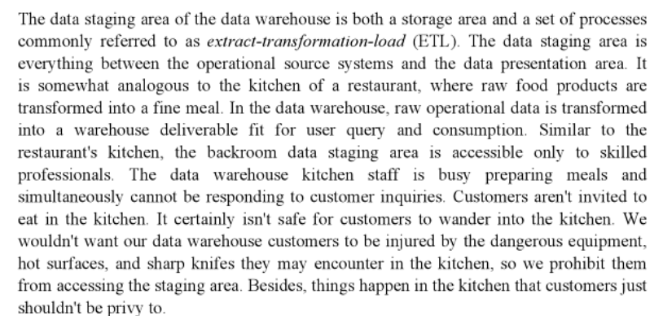
Data Staging Area

Slide 7
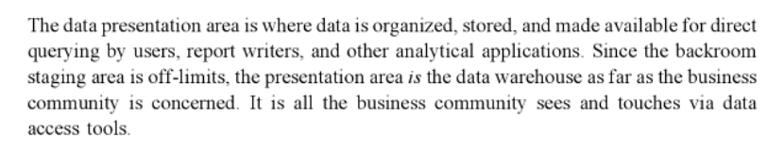
Data Presentation

Slide 8
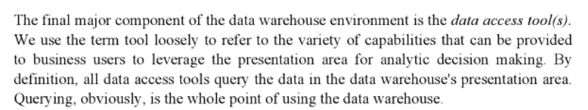
Data Access Tool

Slide 9
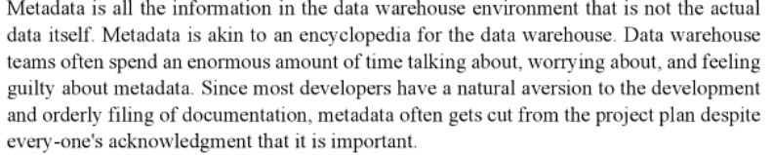
Metadata

Slide 10
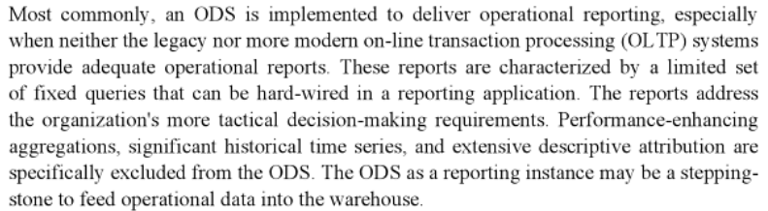
Operational Data Store

Slide 11
ETL Process
In general The ETL Process is…
Capture
Scrub or data cleansing
Transform
Load and Index
ETL – Extract Transform and Load

Slide 12
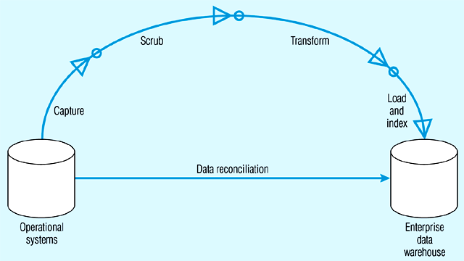
Steps in data reconciliation
Capture = extract…obtaining a snapshot of a chosen subset of the source data for loading into the data warehouse
Static extract = capturing a snapshot of the source data at a point in time
Incremental extract = capturing changes that have occurred since the last static extract

Slide 13
Steps in data reconciliation (continued)
Scrub = cleanse…uses pattern recognition and AI techniques to upgrade data quality
Fixing errors: misspellings, erroneous dates, incorrect field usage, mismatched addresses, missing data, duplicate data, inconsistencies
Also: decoding, reformatting, time stamping, conversion, key generation, merging, error detection/logging, locating missing data

Slide 14
Steps in data reconciliation (continued)
Transform = convert data from format of operational system to format of data warehouse
Record-level:
Selection – data partitioning
Joining – data combining
Aggregation – data summarization
Field-level:
single-field – from one field to one field
multi-field – from many fields to one, or one field to many

Slide 15
Steps in data reconciliation (continued)
Load/Index= place transformed data into the warehouse and create indexes
Refresh mode: bulk rewriting of target data at periodic intervals
Update mode: only changes in source data are written to data warehouse

Slide 16
Design Requirements
Design of the DW must directly reflect the way the managers look at the business
Should capture the measurements of importance along with parameters by which these parameters are viewed
It must facilitate data analysis, i.e., answering business questions

Slide 17
ER Modeling
A logical design technique that seeks to eliminate data redundancy
Illuminates the microscopic relationships among data elements
Perfect for OLTP systems
Responsible for success of transaction processing in Relational Databases

Slide 18
Problems with ER Model
ER models are NOT suitable for DW?
End user cannot understand or remember an ER Model. End User cannot navigate an ER Model.
Many DWs have failed because of overly complex ER designs
ER modeling is not optimized for complex, ad-hoc queries. They are optimized for repetitive narrow queries
Data retrieval becomes difficult due to normalization
Use of ER modeling technique defeats this basic allure of data warehousing, namely intuitive and high performance retrieval of data because it leads to highly normalized relational tables.

Slide 19
Compare ER and Dimensional Modeling
ER Data Modeling | Dimensional Modeling
Data is Stored in RDBMS | Data is stored in RDBMS or Multidimensional database
Tables are Units of Storage | Cubes are Units of storage
Data is Normalized and used for OLTP, optimized for OLTP processing | Data is De-normalized and used in Data Warehouse and Data mart. Optimized for OLAP
Several tables and chain of relationship among them | Few tables and fact tables are connected to dimensional tables
Volatile (several updates) and time variant | Non-volatile and time variant
SQL is used to manipulate data | ETL tools are used to manipulate data
Detailed level transactional data | Summary of bulk transactional data (aggregates and measure ) used in business decisions
Normal Reports | User friendly, interactive drag and drop multidimensional OLAP reports

Slide 20
Dimensional Modeling: Vocabulary
Measures or facts
Facts are “numeric” & “additive”
  For example; Sale Amount, Sale Units
Dimensions
Star Schemas
Snowflake & Starflake Schemas
Sales Amt = f (
Product,
Location,
Time)
Fact
Dimensions

Slide 21
Dimensional Modeling
Dimensions are organized into hierarchies
  E.g., Time dimension: days → weeks → quarters
  E.g., Product dimension: product → product line → brand
Dimensions have attributes
Time Store
Date
Month
Year
StoreID
City
State
Country
Region
CSE601

Slide 22
Dimension Hierarchies
Store Dimension
Product Dimension
Total
Total
Region
Manufacturer
District
Brand
Stores
Products
CSE601
Notes:
1
The simple model we will use to demonstrate the various design alternatives is composed of three dimensions. Only two are shown, Store and Product. The third, Time, is composed of the following attribute hierarchy: date -> month -> quarter -> year.
The Store dimension has an attribute hierarchy of store -> district -> region. Products is composed of products -> brand -> manufacturer.
Based on this simple model, we can see that the granularity of data is products sold in stores by day.

Slide 23
Multi-Dimensional Data
Measures - numerical (and additive) data being tracked in business, can be analyzed and examined
Dimensions - business parameters that define a transaction, relatively static data such as lookup or reference tables
  Example: Analyst may want to view sales data (measure) by geography, by time, and by product (dimensions)
CSE601

Slide 24
The Multi-Dimensional Model
“Sales by product line over the past six months”
“Sales by store between 1990 and 1995”
Store Info
Key columns joining fact table
to dimension tables
Numerical Measures
Prod Code Time Code Store Code Sales Qty
Fact table for
measures
Product Info
Dimension tables
Time Info
. . .
CSE601

Slide 25
Multidimensional Modeling
Multidimensional modeling is a technique for structuring data around the business concepts
ER models describe “entities” and “relationships”
Multidimensional models describe “measures” and “dimensions”
CSE601

Slide 26
Schema Design
Most data warehouses use a star schema to represent multi-dimensional model.
Each dimension is represented by a dimension table that describes it.
A fact table connects to all dimension tables with a multiple join. Each tuple in the fact table consists of a pointer to each of the dimension tables that provide its multi-dimensional coordinates and stores measures for those coordinates.
The links between the fact table in the center and the dimension tables in the extremities form a shape like a star.
CSE601

Slide 27
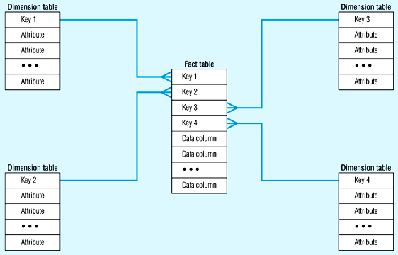
Star Schema (in RDBMS)
CSE601

Slide 28
The “Classic” Star Schema
Fact Table
Store Dimension
STORE KEY
PRODUCT KEY
Time Dimension
STORE KEY
PERIOD KEY
PERIOD KEY
Store Description
City
State
District ID
District Desc.
Region_ID
Region Desc.
Regional Mgr.
Dollars_sold
Units
Dollars_cost
Period Desc
Year
Quarter
Month
Day
Product Dimension
PRODUCT KEY
Product Desc.
Brand
Color
Size
Manufacturer

Slide 29
Fact Tables
In data warehousing, a Fact table consists of the measurements, metrics or facts of a business process. It is located at the center of a star schema or a snowflake schema surrounded by dimension tables.
The primary key of a fact table is usually a composite key that is made up of all of its foreign keys.
Contains numerical measurements of the business
Each measurement is taken at the intersection of all dimensions
Intersection is the composite key
Represents Many-to-many relationships between dimensions
Examples of facts
Sale_amt, Units_sold, Cost, Customer_count

Slide 30
Dimension Tables
Dimension tables contain descriptive attributes (or fields) that are typically textual fields (or discrete numbers that behave like text).
Contains attributes for dimensions
50 to 100 attributes common
Best attributes are textual and descriptive
DW is only as good as the dimension attributes
Contains hierarchal information
Entry points into the fact table

Slide 31
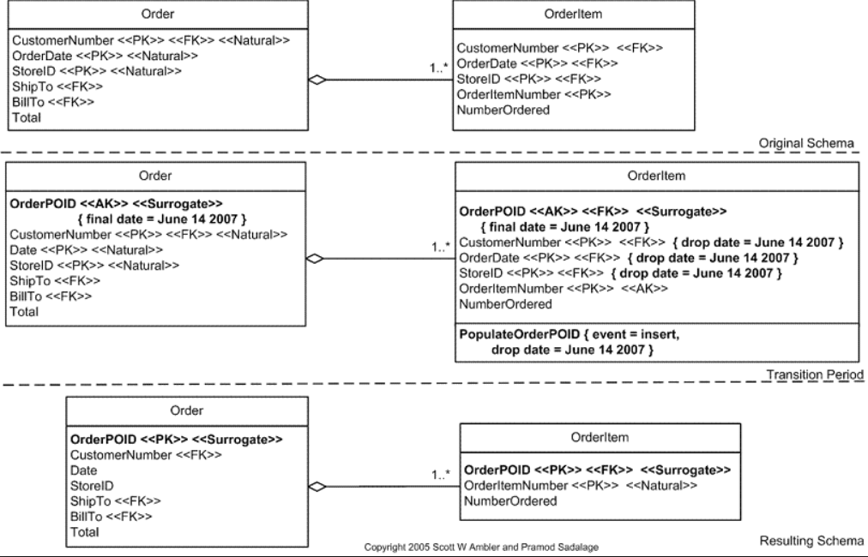
Surrogate Key
A surrogate key is any column or set of columns that can be declared as the primary key instead of a "real" or natural key. Sometimes there can be several natural keys that could be declared as the primary key, and these are all called candidate keys. So a surrogate is a candidate key.

Slide 32
Primary Key Vs Surrogate Key
A primary key is a special constraint on a column or set of columns. A primary key constraint ensures that the column(s) so designated have no NULL values, and that every value is unique.
Physically, a primary key is implemented by the database system using a unique index, and all the columns in the primary key must have been declared NOT NULL. A table may have only one primary key, but it may be composite (consist of more than one column).
A surrogate key is any column or set of columns that can be declared as the primary key instead of a "real" or natural key. Sometimes there can be several natural keys that could be declared as the primary key, and these are all called candidate keys. So a surrogate is a candidate key.
A table could actually have more than one surrogate key, although this would be unusual.
  The most common type of surrogate key is an incrementing integer, such as an auto_increment column in MySQL, or a sequence in Oracle, or an identity column in SQL Server.

Slide 33
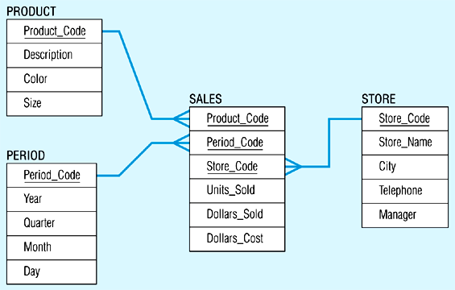
Star Schema Example
CSE601

Slide 34
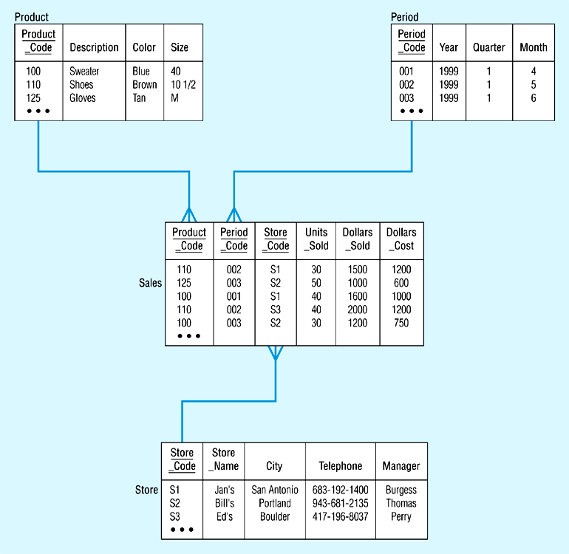
Star Schema with Sample Data
CSE601

Slide 35
Types of Facts
Fully-additive-all dimensions
  Units_sold, Sales_amt
Semi-additive-some dimensions
  Account_balance, Customer_count
  28/3,tissue paper,store1, 25, 250,20
  28/3,paper towel,store1, 35, 350,30
  Is no. of customers who bought either tissue paper or paper towel is 50? NO.
Non-additive-none
  Gross margin=Gross profit/amount
  Note that GP and Amount are fully additive
  Ratio of the sums and not sum of the ratios

Slide 36
Numeric measures in a fact table fall into three categories
Fully additive : The most ﬂexible and useful facts are fully additive; additive measures can be summed across any of the dimensions associated with the fact table.
  An example of a fully additive measure is sales (purchases from a store). You can add hourly sales to get the sales for a day, week, month, quarter, or year. You can add sales across stores or regions
Semi-additive measures can be summed across some dimensions, but not all; checking account or savings account balance amounts are common semi-additive facts.
  You can recreate a balance amount from the transactions file, but it doesn't make any sense to add the balance amounts from October, November, and December (across the time dimension).
Non-Additive : some measures are completely non-additive, such as ratios.
  A good approach for non-additive facts is, where possible, to store the fully additive components of the non-additive measure and sum these components into the ﬁnal answer set.

Slide 37
Data Warehouse: Design Steps
Step 1: Identify the Business Process
We will model the sales process
Step 2: Declare the Grain
We will keep the most granular data (an individual line in the EPOS (electronic point sale ) receipt
Note that each line in an EPOS receipt contains individual product (SKU) and its selling price along with other details like product description and quantity.

Slide 38
Data Warehouse:
Design Steps
Step 3: Identify the Dimensions
The dimensions identified are date/time, product, store, and promotion
Step 4: Identify the Facts
The facts are quantity sold, dollar revenue, dollar cost, and customer count

Slide 39
Grocery Store: The Universal Example
The Scenario:
Chain of 100 Grocery Stores
60000 individual products in each store
10000 of these products sold on any given day(average)
3 year data

Slide 40
Grocery Store DW
Step 1: Sales Business Process
Step 2: Daily Grain
A word about GRANULARITY
  Temp sensor data: per ms, sec, min, hr?
  Size of the DW is governed by granularity
  Daily grain (club products sold on a day for each store) Aggregated data
  Receipt line Grain (each line in the receipt is recorded – finest grain data)

Slide 41
Grocery Store: DW Size Estimate
Daily Grain
Size of Fact Table
= 100*10000*3*365
= 1095 million records
3 facts & 4 dimensions (49 bytes)
1095 m * 49 bytes = 53655 m bytes
i.e. ~ 50 GB

Slide 42
Thank You
Any Questions?

